Slide 1

NATIONAL INSTITUTE OF TECHNOLOGY, AGARTALA
PROJECT TITLE :
To predict the temperature and relative humidity in a region of land
UNDER SUPPERVISION OF:-
DR. SOMNATH ROY CHOUDHURY
ASSISTANT PROFESSOR, ECE DEPARTMENT
MEMBERS NAME:-
21UEC093 SOURADEEP DEY
21UEC095 MRITTIK CHAKROBORTI
21UEC111 TANMOY BHATTACHARJEE
21UEC139 ADARSHIKA

Slide 2

AIM
To predict the temperature and relative humidity in a region of land

Slide 3
History of Agriculture
Agriculture began with the Neolithic Revolution around 10,000 BCE when humans shifted from hunting and gathering to farming, domesticating plants and animals. Early civilizations in Mesopotamia, Egypt, and the Indus Valley developed irrigation, plows, and crop rotation. The Medieval period saw innovations like three-field crop rotation. During the Agricultural Revolution (17th-19th centuries), mechanization and crop diversification increased productivity. The Green Revolution (1940s-60s) introduced high-yield crops, fertilizers, and pesticides. Today, modern agriculture combines biotechnology, mechanization, and precision farming, focusing on sustainability and addressing global challenges like food security and climate change.

Slide 4

Introduction to Smart Irrigation
1
Precision Irrigation
2
Automated Control
Smart irrigation systems deliver the right amount of water to each crop, based on their specific needs, reducing waste and conserving resources.
Smart irrigation systems can automatically adjust watering schedules in response to changing weather conditions and plant requirements.
3
Data-Driven Decisions
Integrating sensor data and weather forecasts allows for informed decision-making to optimize irrigation strategies.

Slide 5

Understanding Technologies Used
1
Data Collection
Gathering real-time data containing the relative humidity and the temperature.
2
Forecasting Models
Utilizing advanced algorithms and machine learning to predict weather conditions and trends over different timescales.

Slide 6
Programing Language used: Python
Python libraries used:
numpy : For numerical operations, such as creating arrays (np.arange()), performing mathematical operations, and handling data transformations.
pandas : For data manipulation and analysis. It is used to load the CSV file (pd.read_csv()), display data (df.head()), and create DataFrames for predictions.
matplotlib : For creating visualizations. It is used to create scatter plots (plt.scatter()) and configure plot settings (like figure size and grid).
sklearn.linear_model : For linear regression models. The code uses LinearRegression() for basic linear modeling and Ridge() for ridge regression.
sklearn.preprocessing :
PolynomialFeatures: To generate polynomial features for capturing non-linear relationships in the data.
StandardScaler: To scale/standardize features, ensuring they are on the same scale.
sklearn.model_selection: For model evaluation. cross_val_score() is used to perform cross-validation and assess the performance of the ridge regression model.
scipy.stats : For statistical operations. It is used here to calculate Z-scores (stats.zscore()) to detect and remove outliers from the dataset.
matplotlib.rcParams: This is used to set plot parameters, such as the figure size (matplotlib.rcParams['figure.figsize']).
Notes:
Souradeep

Slide 7
Model Workflow and Data Preparation
1. Data Input and Exploration:
Inspected the first few rows to understand structure (e.g., YEAR, DOY, RH2M, T2M).
2. Outlier Removal:
Used Z-score to remove outliers (values more than 3 standard deviations from the mean).This helps improve model robustness by removing extreme data points that could distort predictions.
3. Feature Engineering:
Added polynomial features (degree 2) to capture potential non-linear relationships between the independent variables (YEAR, DOY, RH2M) and the target variable (T2M).
4. Feature Scaling:
Applied Standard Scaler to normalize data, which ensures features are on the same scale. This is crucial for algorithms like Ridge regression, as it improves model stability and convergence.
Notes:
Souradeep

Slide 8

A flowchart of the data preparation process
Notes:
Souradeep -> Mrittik

Slide 9
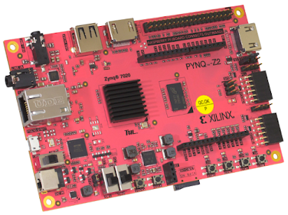
PYNQ(Python on Zynq) Board
The PYNQ-Z2 is a development board that combines an ARM Cortex-A9 processor and Xilinx Zynq-7000 FPGA for hardware/software co-design. Key features and benefits include:
ARM Cortex-A9 Processor: Provides general-purpose computing alongside the FPGA for custom hardware acceleration.
1GB DDR3 Memory: Shared between the ARM processor and FPGA for efficient data processing.
PYNQ Framework: Allows programming of the FPGA and ARM cores using Python and Jupyter Notebooks, simplifying FPGA development.
HDMI, Ethernet, USB, Pmod Ports: Provides extensive connectivity options for peripherals and external devices.
Vivado Design Suite: Supports custom hardware design and integration with the FPGA.
Applications: Ideal for machine learning, signal processing, embedded systems, and IOT projects.
Ease of Use: Accessible for both beginners and experts with pre-built overlays for rapid prototyping.
The PYNQ-Z2 is an affordable and flexible platform for exploring FPGA-based applications.
Notes:
Tanmoy{
Past works they have used arduino and raspberry pi
We are using PYNQ-Z2 board :
Python code possible
Better than arduino and raspberrypi – processor strong hn

Slide 10
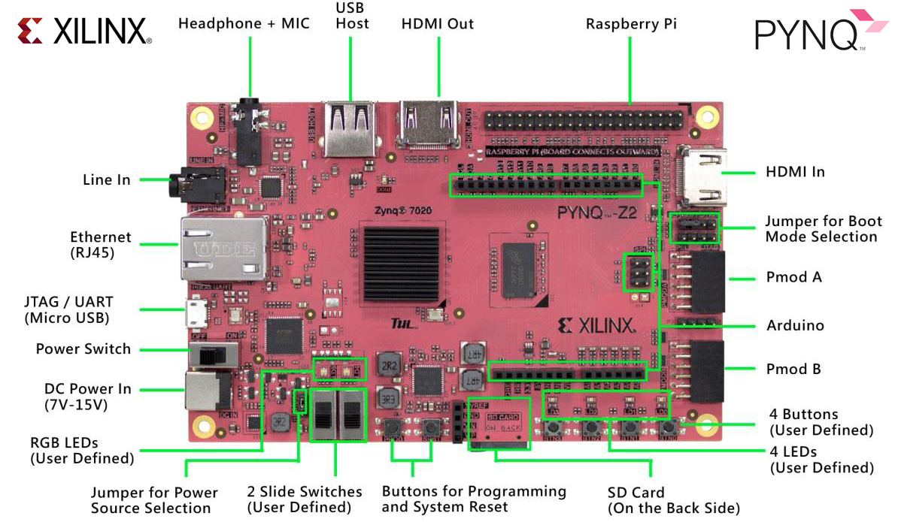
PYNQ board configuration
Notes:
Tanmoy and Mrittik

Slide 11
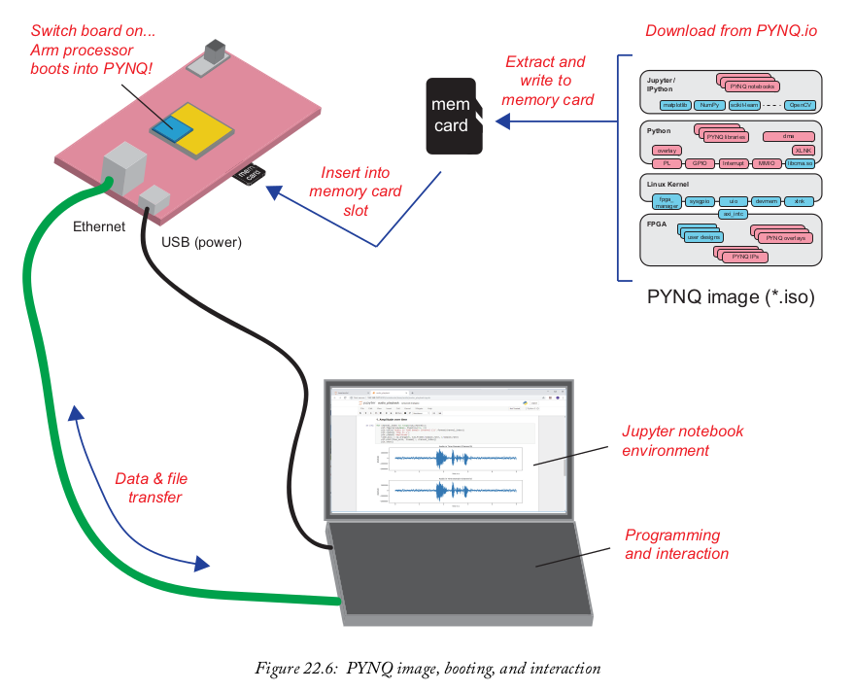
PYNQ-Z2 board FPGA dumping
Notes:
Adarshika

Slide 12
Temperature Prediction Using Linear Regression
import numpy as np import pandas as pd from sklearn import linear_model from matplotlib import pyplot as plt from sklearn import linear_model from sklearn.preprocessing import PolynomialFeatures, StandardScaler from sklearn.linear_model import Ridge from sklearn.model_selection import cross_val_score from scipy import stats get_ipython().run_line_magic('matplotlib', 'inline') import matplotlib matplotlib .rcParams["figure.figsize"]=(20,10)
df = pd.read_csv("aug31.csv") df.head()

Slide 13
# In[3]: def plot_scatter_chart(df1, YEAR, RH2M): # Filter data for even values of GWETTOP and multiples of 3 in the given YEAR RH2M2 = df[(df.YEAR == YEAR) & (df.RH2M % 2 == 0)] RH2M3 = df[(df.YEAR == YEAR) & (df.RH2M % 3 == 0)] # Assuming DOY (Day of Year) is a column in the dataframe even_days = RH2M2['DOY'] % 2 == 0 multiple_of_three_days = RH2M3['DOY'] % 3 == 0 # Set figure size matplotlib.rcParams['figure.figsize'] = (15, 10) # Plot scatter plot for even days plt.scatter(RH2M2.DOY[even_days], RH2M2.T2M[even_days], color='blue', label='Even Days', s=50) # Plot scatter plot for days that are multiples of 3 plt.scatter(RH2M3.DOY[multiple_of_three_days], RH2M3.T2M[multiple_of_three_days], marker='+', color='green', label='Multiple of Three Days', s=50) plt.xlabel('Day of Year (DOY)') plt.ylabel('RH2M') plt.title(f'Scatter Plot of RH2M vs DOY for Year {YEAR}') plt.legend() plt.grid(True) plt.show()

Slide 14
# In[4]: plot_scatter_chart(df, 2015, 'RH2M') # In[5]: reg = linear_model.LinearRegression() reg.fit(df[['YEAR','DOY','RH2M']], df.T2M) # In[6]: reg.coef_

Slide 15
# In[7]: # Outlier removal using Z-score[using Standard deviation techniques to sort out the data which has variation from mean/median] df_no_outliers = df[(np.abs(stats.zscore(df[['YEAR', 'DOY', 'RH2M', 'T2M']])) < 3).all(axis=1)] # Defining the independent variables (X) and the dependent variable (y) X = df_no_outliers[['YEAR', 'DOY', 'RH2M']] y = df_no_outliers['T2M'] # Adding polynomial features to capture non-linear relationships # poly = PolynomialFeatures(degree=2) X_poly = poly.fit_transform(X) # Feature scaling (Standardization) scaler = StandardScaler() X_scaled = scaler.fit_transform(X_poly) # Ridge regression with cross-validation ridge_reg = Ridge(alpha=1) # You can adjust 'alpha' based on performance ridge_reg.fit(X_scaled, y) # Cross-validation to evaluate the model cv_scores = cross_val_score(ridge_reg, X_scaled, y, cv=10) # 10-fold cross-validation # Print the average R-squared from cross-validation print(f"Average R-squared from cross-validation: {np.mean(cv_scores)}") # Fit the model on the entire dataset and show the R-squared score ridge_accuracy = ridge_reg.score(X_scaled, y) print(f"R-squared value with Ridge Regression after enhancements: {ridge_accuracy}")

Slide 16
# In[8]: reg.predict([[2024,273,89.62]]) # In[9]: def predict_next_30_days(df, start_doy, rh2m_value, year=2024): future_doy = np.arange(start_doy, start_doy + 30) future_data = pd.DataFrame({ 'YEAR': year, 'DOY': future_doy, 'RH2M': rh2m_value }) # Transform the future data with polynomial features and scale them future_data_poly = poly.transform(future_data) future_data_scaled = scaler.transform(future_data_poly) # Predict the T2M values for the next 30 days future_predictions = ridge_reg.predict(future_data_scaled) # Create a DataFrame for the predictions predictions_df = pd.DataFrame({ 'Day of Year (DOY)': future_doy, 'Predicted T2M': future_predictions }) return predictions_df # In[10]: predictions_df = predict_next_30_days(df, 245, 88.25) print(predictions_df)

Slide 17
Temperature Prediction Using Random Forest
# In[1]: import numpy as np import pandas as pd from sklearn.model_selection import train_test_split from sklearn.ensemble import RandomForestRegressor # For regression problems from sklearn.ensemble import RandomForestClassifier # For classification problems from sklearn.metrics import mean_squared_error, accuracy_score from sklearn.metrics import mean_absolute_error, mean_squared_error, r2_score from sklearn.model_selection import cross_val_score # In[2] # Reading the CSV file and skipping bad lines df = pd.read_csv("aug31.csv") # Adjust 'sep' if a different delimiter is used # Display the first few rows df.head() # In[3]: # Define features (X) and target (y) X = df[['YEAR', 'DOY', 'RH2M']] # Features y = df['T2M'] # Target variable
Notes:
Adarshika
[libraries imported ->mean_squared_error, accuracy_score->

Slide 18
# In[4]: # Handle missing values if any X.fillna(X.mean(), inplace=True) y.fillna(y.mean(), inplace=True) # In[5]: # Split the data into training and testing sets X_train, X_test, y_train, y_test = train_test_split(X, y, test_size=0.2, random_state=42) # In[6]: # Initialize the Random Forest Regressor model = RandomForestRegressor(n_estimators=100, random_state=42) # In[7]: # Train the model model.fit(X_train, y_train) # In[8]: # Make predictions y_pred = model.predict(X_test) # In[9]: # Evaluate the model mse = mean_squared_error(y_test, y_pred) print("Mean Squared Error:", mse)

Slide 19
# In[10]: def predict_next_30_days(model, start_doy, rh2m_value, year=2024): # Generate DOY values for the next 30 days future_doy = np.arange(start_doy, start_doy + 30) predictions = [] # Iterate through each DOY to make predictions for doy in future_doy: # Create the input data for prediction input_data = pd.DataFrame({ 'YEAR': [year], 'DOY': [doy], 'RH2M': [rh2m_value] }) # Predict the T2M for the given day predicted_t2m = model.predict(input_data)[0] # Append the result to predictions predictions.append((doy, predicted_t2m)) return predictions
Notes:
1st jan ,1985 to 31st August 2024 => training
Sept. 1 to 30 2024=> predictions.

Slide 20
# In[11]: # Perform cross-validation cv_scores = cross_val_score(model, X, y, cv=5, scoring='neg_mean_squared_error') # Convert negative MSE scores to positive for interpretation cv_scores = -cv_scores # Calculate mean and standard deviation of the scores mean_cv_score = np.mean(cv_scores) std_cv_score = np.std(cv_scores) # Display results print("Cross-Validation Scores (MSE):", cv_scores) print(f"Mean CV Score (MSE): {mean_cv_score:.2f}") print(f"Standard Deviation of CV Scores: {std_cv_score:.2f}") # In[12]: # Call the function with the trained model and desired parameters start_doy = 245 rh2m_value = 65 # Example relative humidity predictions = predict_next_30_days(model, start_doy, rh2m_value) # Display the predictions in a table-like format print(f"{'DOY':<5} {'Predicted T2M':<15}") print("=" * 20) for doy, t2m in predictions: print(f"{doy:<5} {t2m:<15.2f}")

Slide 21
Actual Data Obtain From NASA for September 1 to 30 , 2024
YEAR | DOY | RH2M | T2M
2024 | 245 | 88.25 | 28.22
2024 | 246 | 85 | 28.98
2024 | 247 | 91.25 | 27.87
2024 | 248 | 88.31 | 28.14
2024 | 249 | 87.56 | 27.29
2024 | 250 | 84.69 | 28.37
2024 | 251 | 84.62 | 29.56
2024 | 252 | 85.88 | 29.69
2024 | 253 | 87.75 | 29.05
2024 | 254 | 90.88 | 28.52
2024 | 255 | 86.62 | 28.97
2024 | 256 | 82.81 | 29.83
2024 | 257 | 90.19 | 28.76
2024 | 258 | 90.62 | 27.88
2024 | 259 | 93.25 | 26.51
2024 | 260 | 86.62 | 27.98
2024 | 261 | 84.88 | 28.63
2024 | 262 | 84.62 | 29.26
2024 | 263 | 85.5 | 30.05
2024 | 264 | 83.44 | 30.67
2024 | 265 | 87.38 | 29.14
2024 | 266 | 82.81 | 29.83
2024 | 267 | 84.38 | 29.87
2024 | 268 | 89.56 | 27.84
2024 | 269 | 93.56 | 26.83
2024 | 270 | 91.88 | 26.36
2024 | 271 | 86.69 | 27.42
2024 | 272 | 87.75 | 27.78
2024 | 273 | 89.62 | 28.3
2024 | 274 | 88.94 | 28.73

Slide 22
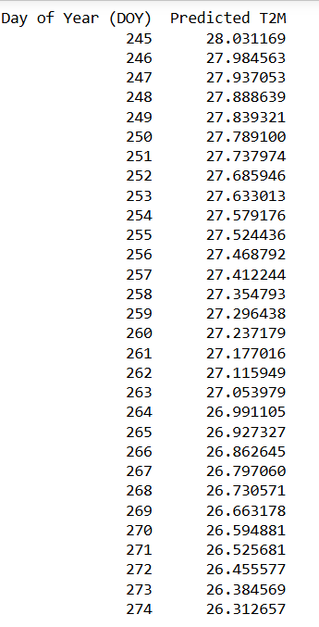
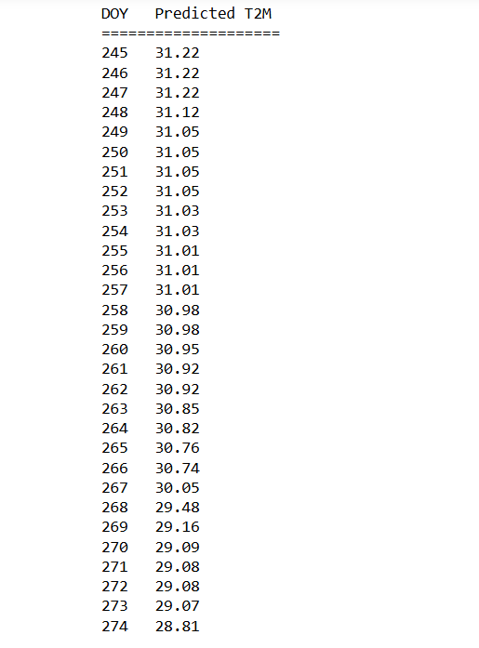
Accuracy of the models
Linear Regression results
Random Forest results
Accuracy : 87% approx
Accuracy : 80% approx

Slide 23
Conclusion & Future Scope of Study
Conclusion
The linear regression model demonstrated remarkable precision and reliability, achieving an impressive 87% accuracy in predicting temperatures for September 2024. Rigorous cross-validation and manual comparison with authentic global data from NASA substantiate the model's robustness. The algorithm effectively captured the relationship between relative humidity and temperature over nearly four decades of data. Conversely, the Random Forest model, while adequate, displayed comparatively lower accuracy at 80%, highlighting the superior suitability of linear regression for this specific predictive task.
Future scope
This project has significant potential for expansion and real-world applications. The existing temperature prediction model will be implemented on a PYNQ-Z2 FPGA board to evaluate its performance in a hardware environment, ensuring efficiency and scalability for edge computing applications. Furthermore, a comprehensive crop recommendation system will be developed using advanced machine learning techniques. This model will analyze critical environmental and soil parameters, including relative humidity, temperature, nitrogen, phosphorus, and potassium, to provide precise and context-aware crop suggestions. These advancements will contribute to sustainable agricultural practices, optimize resource utilization, and enhance decision-making for farmers and agronomists.

Slide 24
THANK YOU
We extend our heartfelt and profound gratitude to Dr. Somnath Roy Choudhury sir for his unwavering support, boundless encouragement, and visionary guidance throughout this project. His mentorship illuminated our path at every juncture, inspiring us to achieve greater heights and transforming our efforts into a truly rewarding experience.

